Slide 1
Programming JAVA {
Hiveed.java
RECURSION;
/* Here is where your journey for your dream begins */
}
JAVA Programming

Slide 2
Hiveed.java
What is Recursion in JAVA :
Recursion is the method technique Where a method call itself directly.
A recursive method breaks down a problem into smaller subproblem of the sametype
And the method itself with a new input.
JAVA Programming

Slide 3
Hiveed.java
Advantages of the Recursive method :
Recursion can provide a clear and concise way to represent problems that have a self-similar structure.
It can lead to more elegant and readable code for certain problems compared to iterative solutions using loops.
It promotes a divide-and-conquer approach to problem-solving.
JAVA Programming

Slide 4
Hiveed.java
Disadvantages of the Recursive method :
Can be less efficient than iterative solutions:
Increased memory usage:
Potential for stack overflow errors:
If the recursion depth is not bounded properly, it can lead to a stack overflow error when the stack runs out of space.
Less intuitive for beginners:
The concept of recursion can be challenging to understand for programmers unfamiliar with the technique.
JAVA Programming

Slide 5
Hiveed.java
Problem :
1.Fibbbonaci Series.
2.Sum of N Natural Number
3.Factorial Number.
JAVA Programming

Slide 6
Hiveed.java
Constructor :
Constructor is a Special block in the class.
The constructor name and the ClassName should be same name.
Constructor didnot have return Type.
Constructor didnot have Modifiers
JAVA Programming

Slide 7
Hiveed.java
Why we need Constructor :
The Constructor is used to load the Non-static menber in the class.
Execute the non-static member in a class.
Execute Programmer written instruction.
JAVA Programming

Slide 8
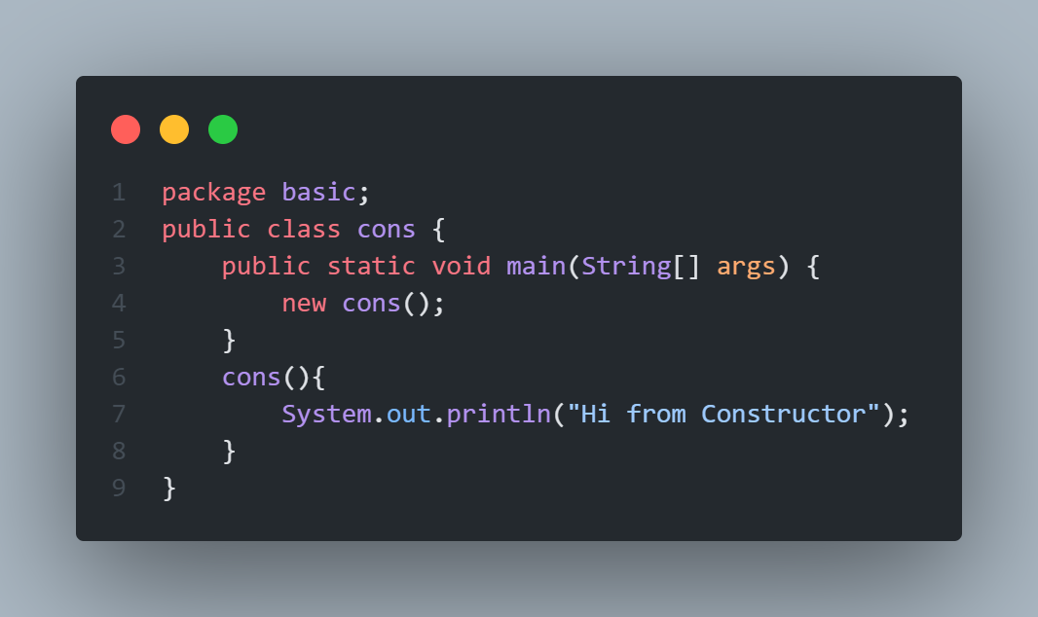
Hiveed.java
Constructor Syntax :
Constructor Calling
Default Constructor
JAVA Programming

Slide 9
Hiveed.java
Constructor
Default Constructor
Parameterized Constructor
JAVA Programming

Slide 10
Hiveed.java
default Constructor :
A Constructor with no formal argument is called default constructor .
Syntax for Default Constructor
JAVA Programming

Slide 11
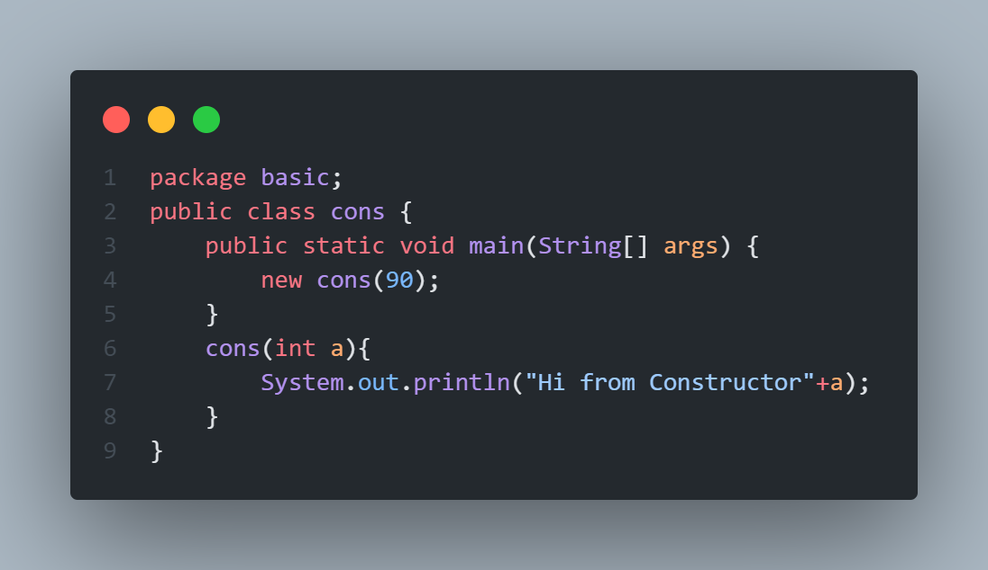
Hiveed.java
Parameterized Constructor :
A Constructor with formal argument is called default constructor .
Syntax for Parameterized Constructor
JAVA Programming

Slide 12
Hiveed.java
Constructor Overloading:
A Class have more than one Constructor with different formal arguments is called the constructor Overloading.
JAVA Programming

Slide 13
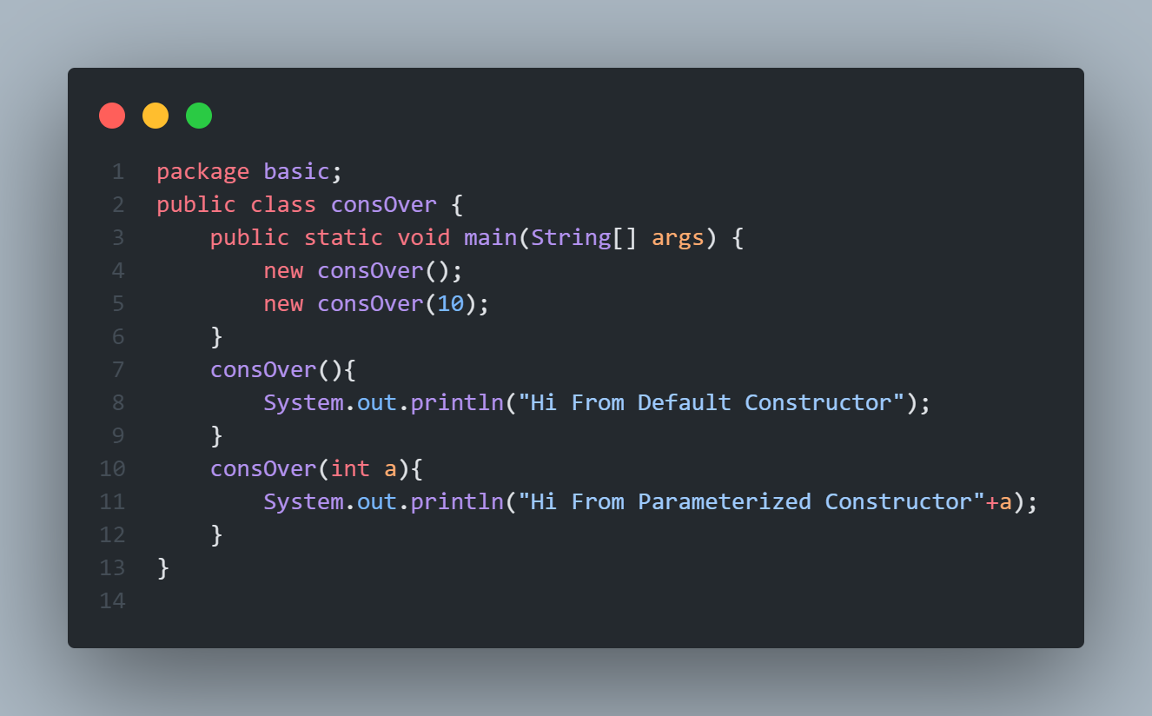
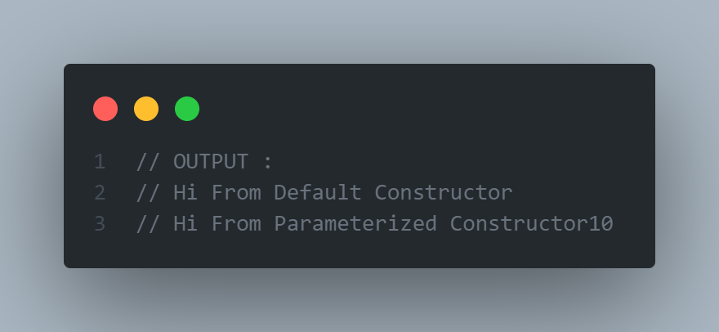
Hiveed.java
JAVA Programming

